Slide 1
Smart Vacuum Cleaning
Submitted To : Dr. Ashima Singh | Submitted By: Jhonsy Bansal (801732025) Gurkirat Singh (801832016) Harmandeep Singh (801832018) Kamal Kant (801832023)

Slide 2
Problem Definition
There is great issue of cleaningness in the country like India although there are various schemes and initiative by the government.
Major attention in robotics research with IOT due to its effectiveness in assisting humans.
Existing robots are either too expensive or sophisticated that cannot be used in general.

Slide 3
Objective Achieved
Connecting and Assembling hardware.
Circuit and pin configuration
Assemble component into the model
Calibrating Hardware.
Arduino Uno Configuration and Coding
Enable IoT (working).
Flashing ESP8266 wifi module.
Configure Blink App

Slide 4
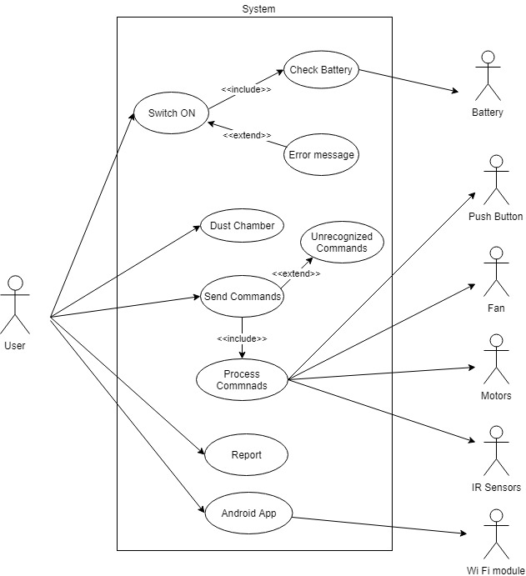
Use Case

Slide 5
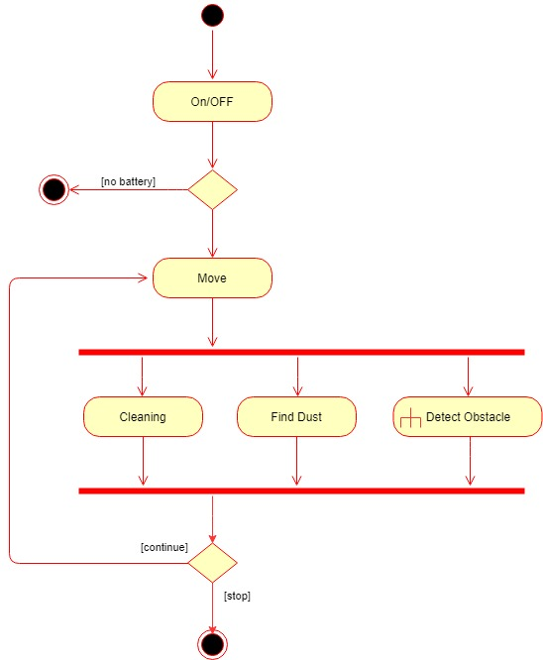
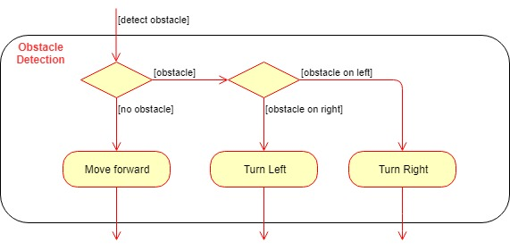
Activity Diagram

Slide 6
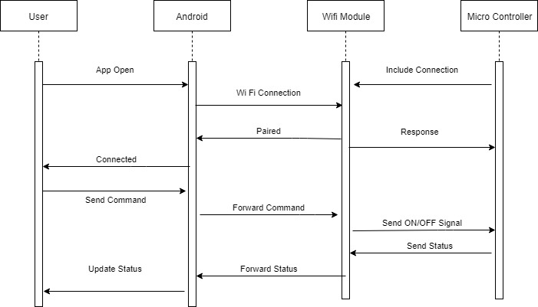
Sequence Diagram

Slide 7
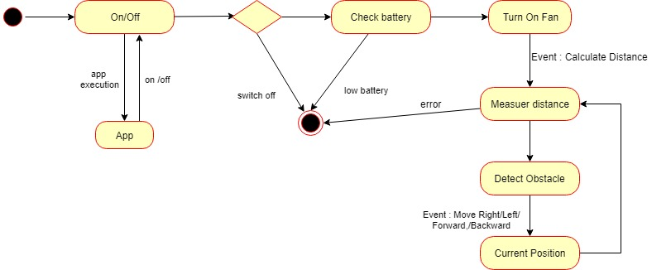
State Diagram

Slide 8
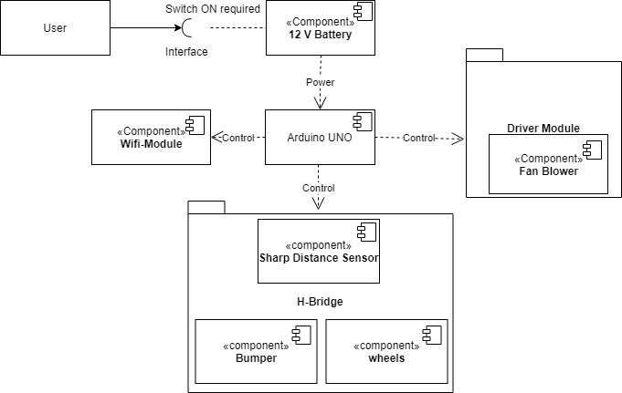
Component Diagram

Slide 9
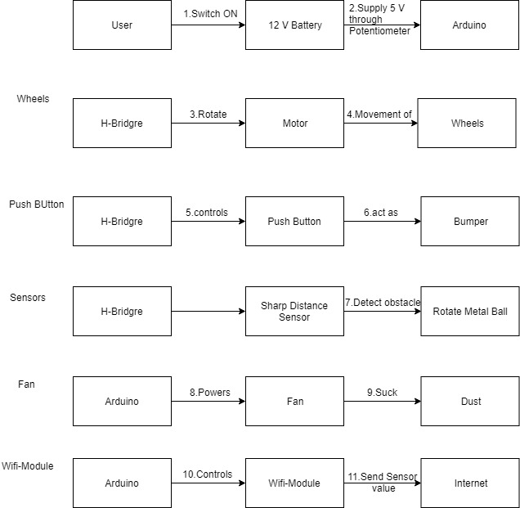
Collaboration Diagram

Slide 10
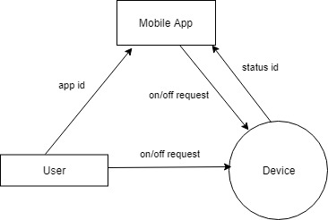
DFD - 0

Slide 11
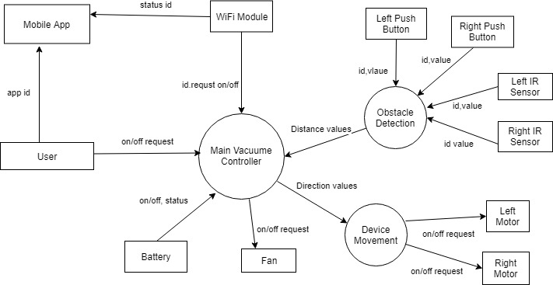
DFD - 1

Slide 12
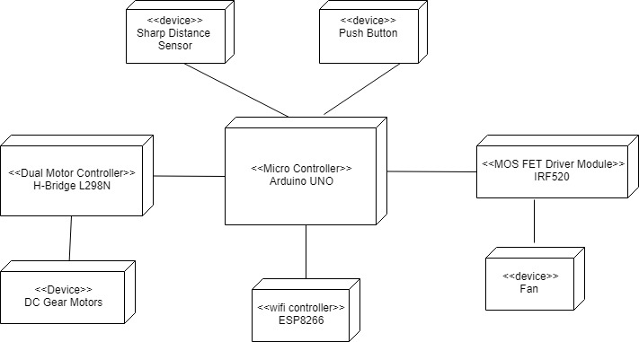
Deployment Diagram

Slide 13
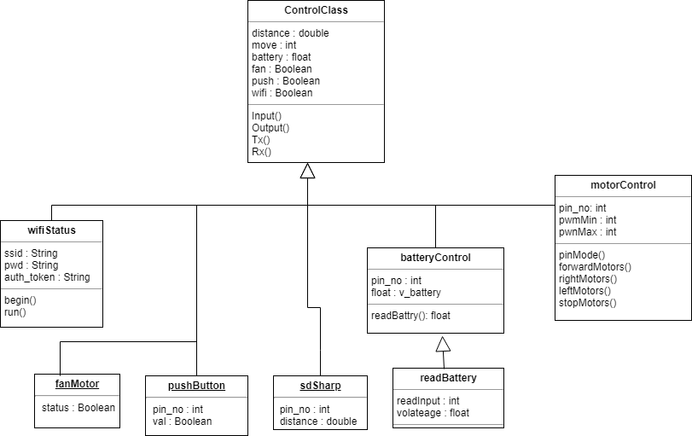
Class Diagram

Slide 14
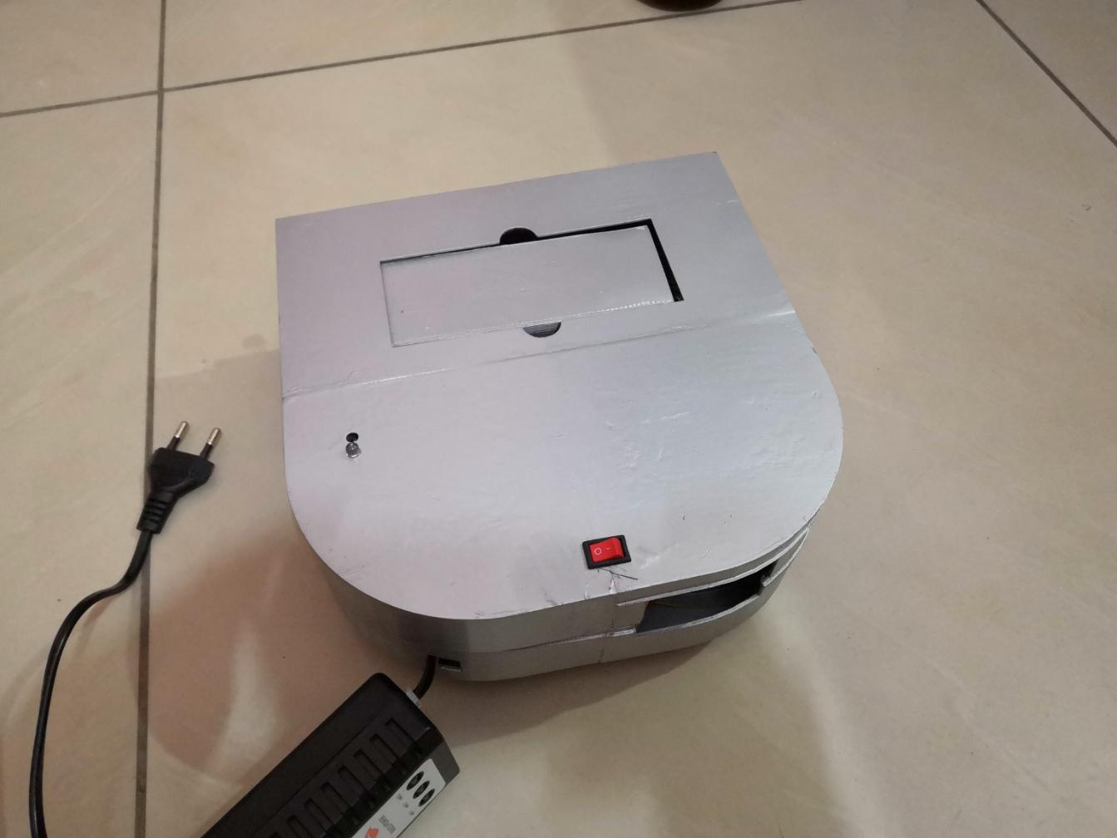
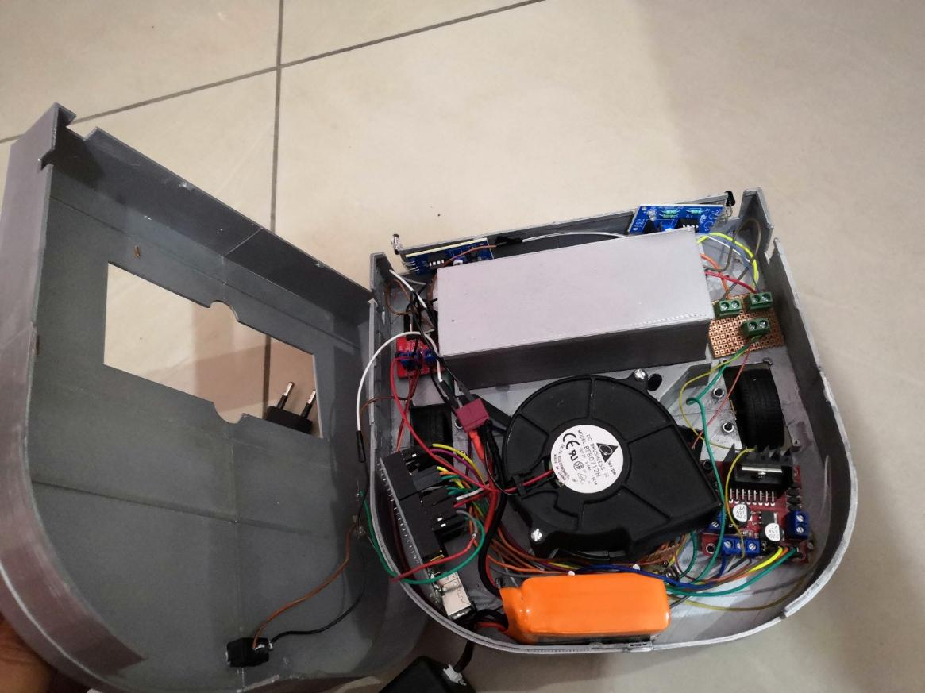
Screenshots

Slide 15
Conclusion and Future Work
Conclusion
The project shows a better and simple approach to provide an overview of design of a simple robotic cleaners design using gadgets and instruments easily available.
This robot is specially made on the basis of modern technology.
It has all the basic features which are required for a floor vacuum cleaner.
Future Work
Include more sensors like depth , ultrasonic
Apply Mapping Algorithm for better cleaning
Use AI Techniques

Slide 16
PERFORMANCE PARAMETERS
Dust collected.
Area(sq feet) covered per minute.
Meantime b etween failure.
Obstacle avoidance capability
TESTING PROCESS
Features:
Cleaning.
Obstacle Detection.
Battery life.
IOT.
Test Cases

